Slide 1
APA Workshop
Val Macias, Librarian
Fullerton College 2019

Slide 2
AGENDA
Why APA?
What’s APA for?
How to use APA: new ways
Pesky APA Problems

Slide 3
EVERY INDUSTRY HAS ITS STANDARDS
and so does
ACADEMIC SOCIAL SCIENCE WRITING

Slide 4
WHY APA?
APA Style is an agreed set of formatting and referencing rules to keep social science writing consistent, uniform, readable and shareable.

Slide 5
WHAT IS APA USED FOR?
APA Is used for:
Reporting scientific findings in the field of psychology
Field research
Journal articles
Dissertation and theses
Student Papers and Reports

Slide 6
THREE TIPS TO GET THE REFERENCE PAGE and other APA stuff RIGHT
(without working so hard)

Slide 7
TIP #1
MODEL AFTER EXAMPLES

Slide 8
Reference list example: Goldenrod copy (Both electronic sources)
Datamonitor. (2011). Microsoft Corporation. Microsoft Corporation SWOT Analysis, 1-10. Retrieved from http://www.ebscohost.com/academic/business-source-complete
Glick, B. (2013, January 29). Microsoft dominance fading
fast with PC market in decline. Computer Weekly (6). Retrieved from http://www.ebscohost.com/academic/academic-search- premier
Online Magazine article

Slide 9
Google: Purdue OWL APA

Slide 10
TIP #2
USE THE ‘CITE’ FEATURE
OF THE DATABASES

Slide 12
TIP #3
USE NoodleTools under A-Z Databases (pink handouts with directions)

Slide 13
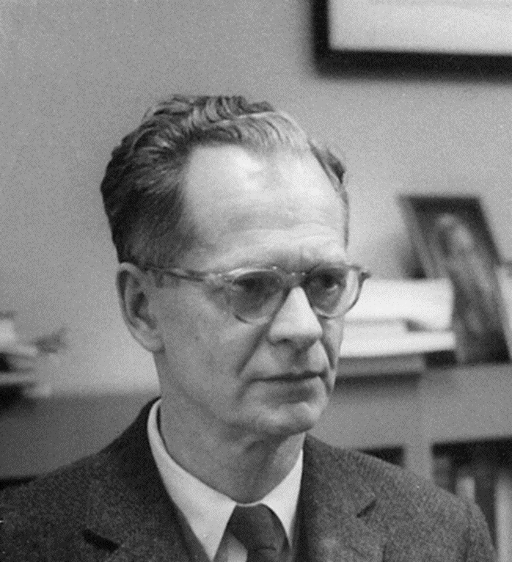
SHELF BROWSING: Browsing Psych Books
Library books are shelved alpha numerically.
Browse section BF for psychology-related books. Bring one back to practice citing.

Slide 14
APA Structure: 4 parts
Title Page
Abstract *
Main Body
References
Times New Roman font, 12 point, double spaced
Notes:
Introductory notes.

Slide 15
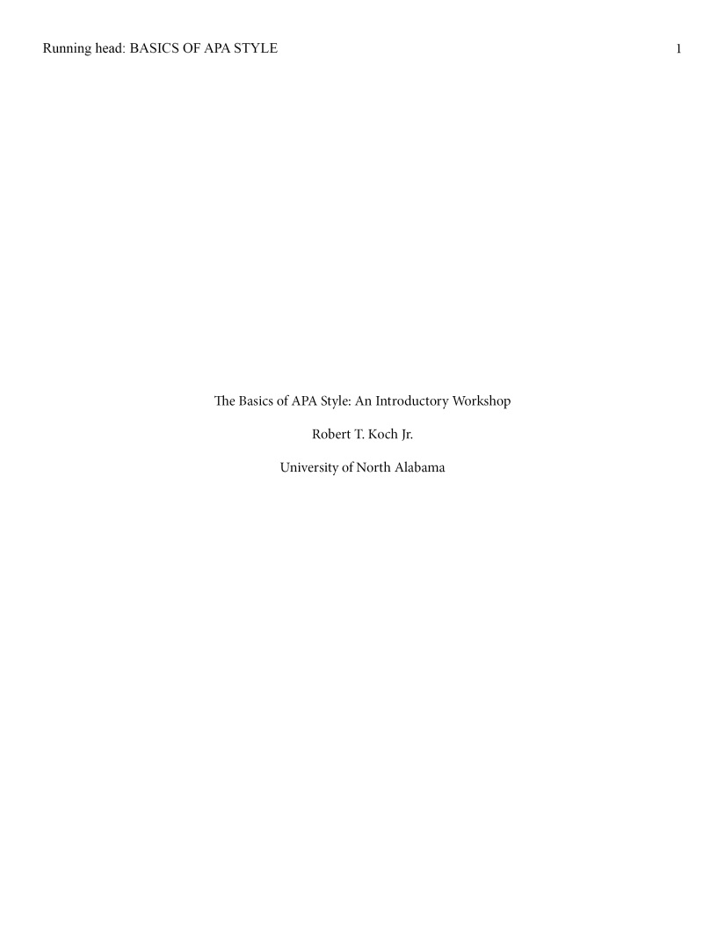
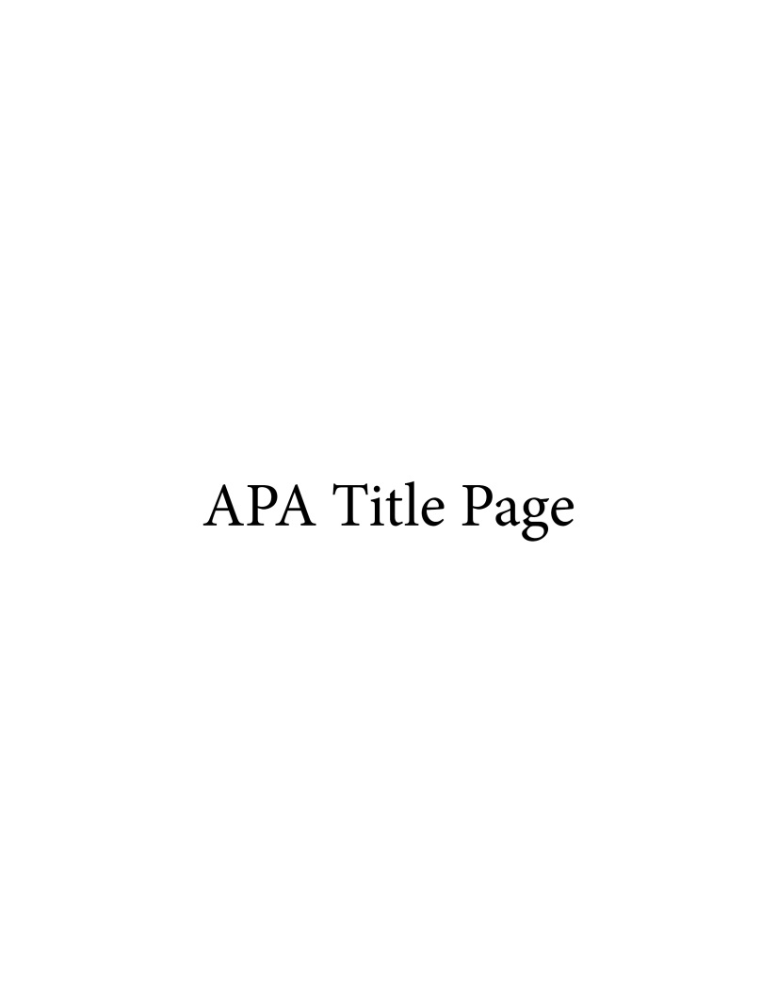
APA Title Page
Center: Title of your paper, your name, and affiliation (Westwood College)
The words “Running head” only appear on title page
Shortened version of main title, not to exceed 50 characters
BUSN100
Introduction to Business
March 2015
Author notes, course information, Date, etc. can be included towards the bottom of the title page
Notes:
Introductory notes.

Slide 16
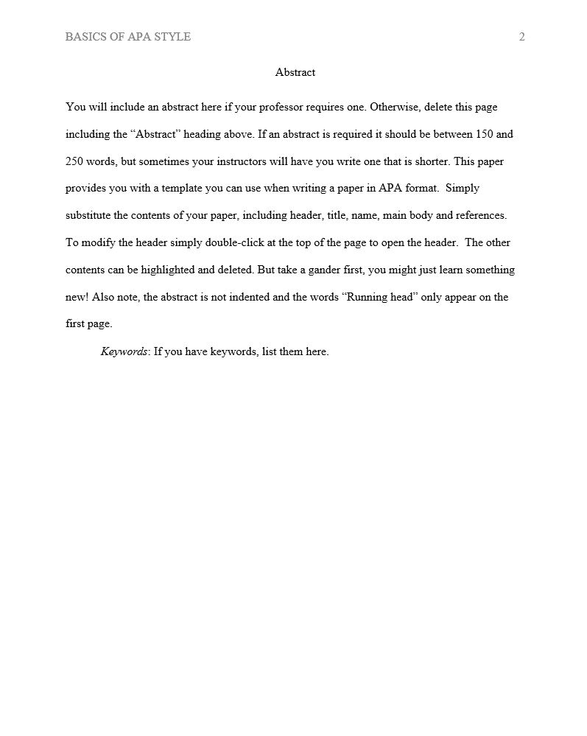
Abstract Page
150 – 250 word summary
In block format (paragraph not indented)
Include preview of thesis statement, main ideas, and key points
Written after paper is completed
Unique terms and abbreviations should also be defined
Notes:
This slide provides a visual example of an abstract page, which consists of a page header, a heading—Abstract, and a brief summary of the paper accurately presenting its contents.
Type the heading –Abstract– centered at the top of the page. Below, type the paragraph of the paper summary (between 150 and 250 words) in block format—without indentation.
The abstract should contain the research topic, research questions, participants, methods, results, data analysis, and conclusions. It may also include possible implications of your research and future work you see connected with your finding, and may include keywords.

Slide 17
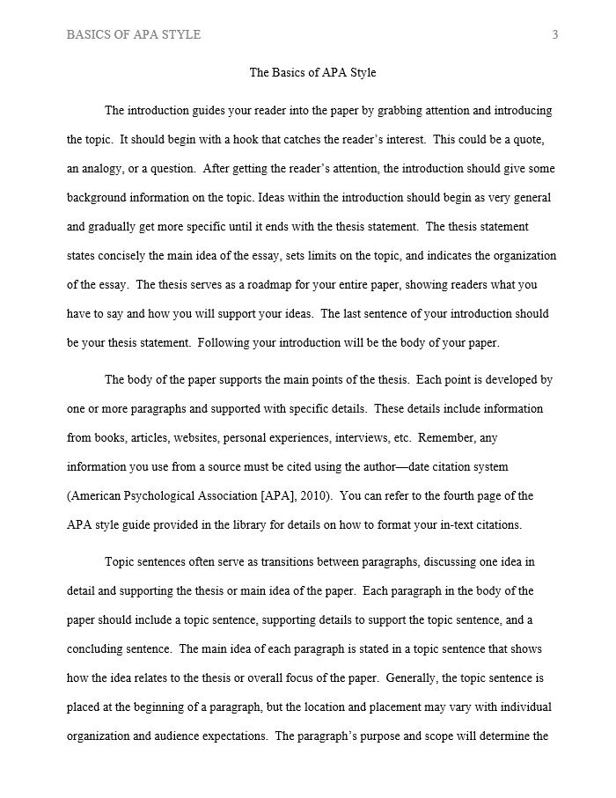
Main Body (Text)
Type and center the title of the paper at the top of the page
Paragraphs are double-spaced, each section following without a break
Identify the sources you use in the paper with citations.
Notes:
This slide provides the basic reminders about formatting the text:
Make sure that the first text page is page number 3 (page#1 is a title page, page #2 is an abstract page).
Start with typing the essay title centered, at the top of the page.
Type the text double-space with all sections following each other without a break. Do not use white space between paragraphs.
Create parenthetical in-text citations to identify the sources used in the paper.
Format tables and figures.
The following slides introduce APA formatting of references, in-text citations, and tables and figures.

Slide 18
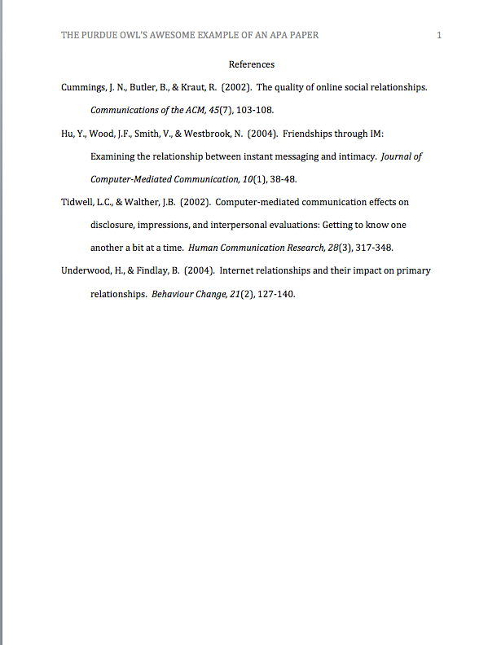
References List
Should be…
in alphabetical order
double spaced
hanging indent
work on your References page as you are inserting citations into your body
Notes:
Relative vocabulary list.

Slide 19
When to Use In-text Citations
Document when:
Quoting –word for word from source, use quotation marks
Paraphrasing – put into your own words, quotation marks not used

Slide 20
When to Use In-text Citations
Document when:
Quoting –word for word from source, use quotation marks
Paraphrasing – put into your own words, quotation marks not used

Slide 21
In-text quotations examples
Sources must always include the author name & year of publication!
For example:
The journey through history can be, as Holmes (2011) describes, “A journey of discovering who we are and where we come from…” (p. 199).
Silent Spring was one of the first books to discuss the dangers of pesticide use (Carsen, 1962).
Note the use of an ellipsis (…)
Title of book in italics

Slide 22
Reference list (from previous slide quotations) (Print sources)
Both Books
Holmes, R. (2011). World War II: The definitive visual history. New York: Random House Publishing.
Carsen, R. (1962). Silent spring. Greenwich, CT: Fawcett.

Slide 23
In-text citation example using paraphrasing
According to Datamonitor (2011), one of Microsoft’s challenges is to compete with its peers in a declining economy (para. 5). Additionally, some analysts believe that global competition will also affect Microsoft’s competitive edge in the years to come (Glick, 2013, para. 3).

Slide 24
#firstworldproblems
“How do I keep “Running Head” from appearing on all of my pages” and other little headaches resolved.

Slide 25
Open a Word Document

Slide 26
Make Sure You Are Using Times New Romans, 12, double spacing
Set to 2.0 for Double Spacing

Slide 27
Cover Page
Open a Word Document
Double-click on the top margin of the page to bring up the Header and Footer Tools.
Tick the ‘Different First Page’ box.

Slide 28
Cover Page
Type in the words Running Head: SHORTENED TITLE IN ALL CAPS
Running head: FEMALE PRISON VIOLENCE

Slide 29
Hit the TAB Key ONCE or TWICE
Running head: FEMALE PRISON VIOLENCE

Slide 30
Click on Page Number
Running head: FEMALE PRISON VIOLENCE
Page number➔Current Position➔Plain Number

Slide 31
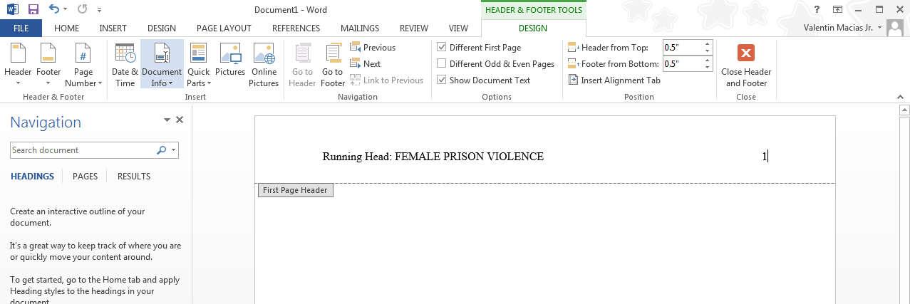
Done.
Running head: FEMALE PRISON VIOLENCE

Slide 32
Set the spacing to 2.0
Running head: FEMALE PRISON VIOLENCE

Slide 33
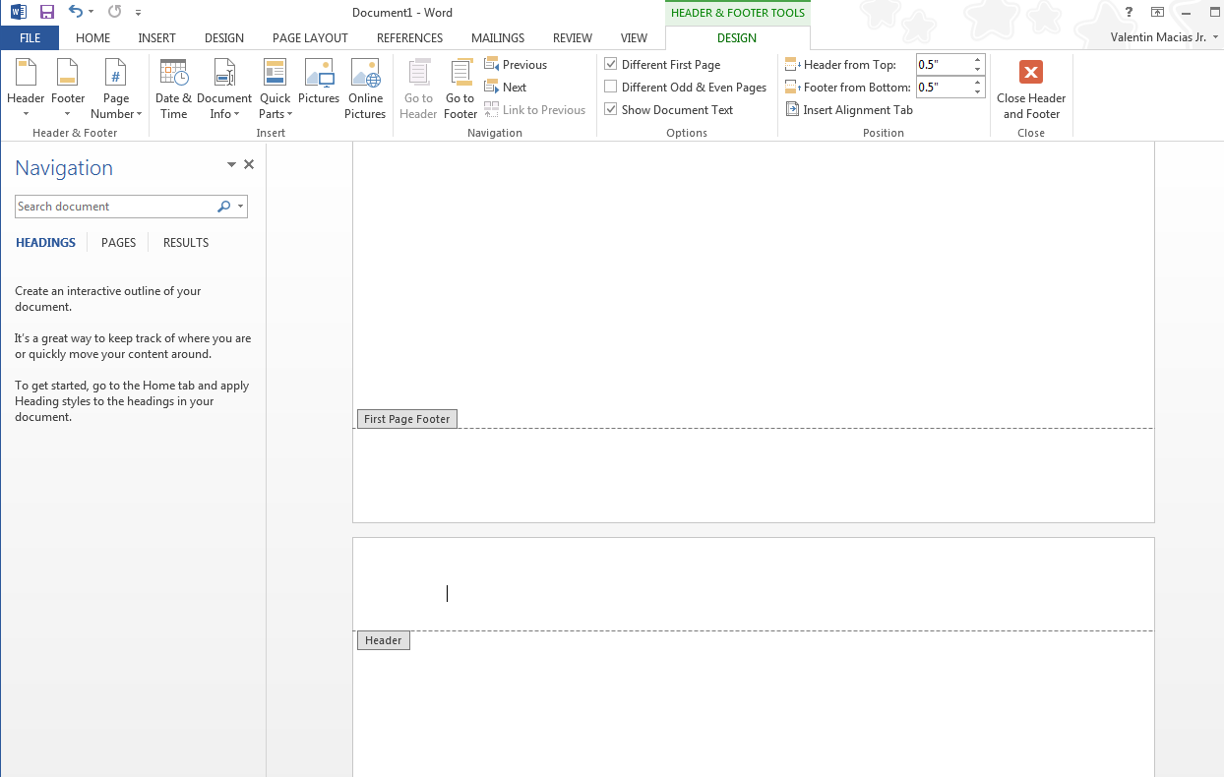
Open the Header again by double clicking the top of your second page

Slide 34
Hit TAB ONCE or TWICE

Slide 35
Click INSERT➔ PAGE NUMBER➔CURRENT POSITION

Slide 36
Done
Close the Header and Footer tools and begin typing your paper per APA rules.
Be sure to set Double Spacing, 12 pt. TMR as needed.

